Slide 1

Using Git with IBM Dependency Based Build (DBB)
Notes:
So the question your probably asking yourself is “how does all this new DevOps technology help me manage my mainframe applications”?
At IBM we realize that building and deploying mainframe application with created a product to

Slide 2
Disclaimer
IBM’s statements regarding its plans, directions, and intent are subject to change or withdrawal without notice and at IBM’s sole discretion.
Information regarding potential future products is intended to outline our general product direction and it should not be relied on in making a purchasing decision.
The information mentioned regarding potential future products is not a commitment, promise, or legal obligation to deliver any material, code or functionality. Information about potential future products may not be incorporated into any contract.
The development, release, and timing of any future features or functionality described for our products remains at our sole discretion.
Performance is based on measurements and projections using standard IBM benchmarks in a controlled environment. The actual throughput or performance that any user will experience will vary depending upon many factors, including considerations such as the amount of multiprogramming in the user’s job stream, the I/O configuration, the storage configuration, and the workload processed. Therefore, no assurance can be given that an individual user will achieve results similar to those stated here

Slide 3
IBM Dependency Based Build (DBB) – Key Features
DBB is a tool that provides an Intelligent build environment for mainframe applications stored in Git.
It can support your overall CI/CD solution as well as support individual developer builds within ZOD & IDzEE..
It uses a multi-language source code scanner to find dependencies for Assembler, C/C++, COBOL, and PL/I source files to automate your build process (compile & link edit).
It comes with a Java API Tool Kit, WebApp and Database to build and manage your application’s dependency metadata and build results.
Use DBB API’s with the Groovy scripting language to automate your builds and drive your deployment process (CD)
Sample Scripts are provided to get you started

Slide 4

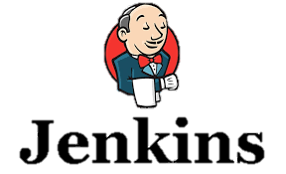








DBB Architecture Overview - CI workflow
DBB, includes a free port of Rocket Software’s Git and Apache’s Groovy runtime for z/OS. It can be configured with any DevOps orchestrator like Jenkins and any Git Host service like Git Hub.
Start Pipeline
DBB WebApp
- Dependency Metadata
- Build Results History
Status, logs and links to reports
Git Server
DBB Toolkit
Main Repository
CLONE to USS
Agent
Groovy Build scripts
USS
MVS
API’s
PDS
Scan, impact analysis, copy to PDS, compile, link-edit & report.
Compile &
link
Run Groovy build script

Slide 5
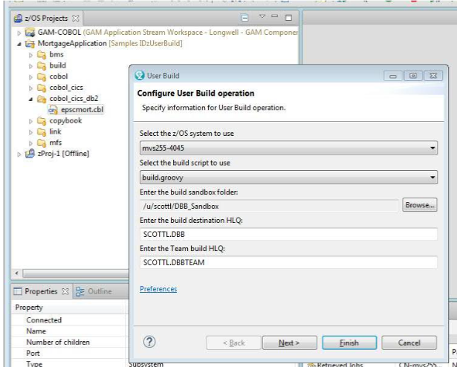
DBB and IDz – User Build
DBB can be used within IDz’s “User Build” feature
Provides all the benefits of a dependency based build
No JCL knowledge needed
Does not rely on Rocket Git or Jenkins

Slide 6


DBB Impact Build Scenarios
Here are 2 scenarios to explain how DBB works when a change is made to a sample application of, lets say, 3 programs and 3 copybooks.
If we change CYP-2, DBB will return a build-list of “PGMS A,B,C“ for the build.
If we change PGM-B, DBB will return “PGMS B & C” for a build.
Sample application and related dependencies in a Repo
DBB Result - Build List
PGM-A
CPY-1
CPY-1
CPY-2
Scenarios
PGM-B
PGM-A
CPY-3
CPY-2
Change CPY-2
PGM-C
PGM-B
CPY-3
PGM-B
CPY-2
PGM-C
Change PGM-B
Static Link
PGM-C
CPY-3

Slide 7
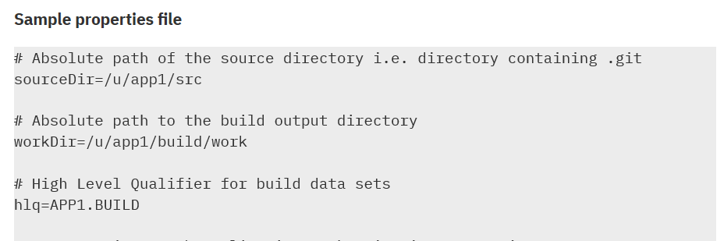
DDB – A Sample Groovy Compile Script
import com.ibm.dbb.build.*
println("Copying source from zFS to PDS . . .")
def copy = new CopyToPDS().file(new File(“$sourceDir/helloworld.cbl"))
.dataset("USR1.BUILD.COBOL").member("HELLO")
copy.execute()
println("Compiling . . .")
def compile = new MVSExec().pgm("IGYCRCTL").parm("LIB")
compile.dd(new DDStatement().name("SYSIN").dsn(“$hlq.BUILD.COBOL(HELLO)")
.options("shr"))
… other dd’s
compile.copy(new CopyToHFS().ddName("SYSPRINT")
.file(new File(“$workDir/build.log")))
def rc = compile.execute() if (rc > 4) …
Blue text are example DBB APIs, orange are properties

Slide 8
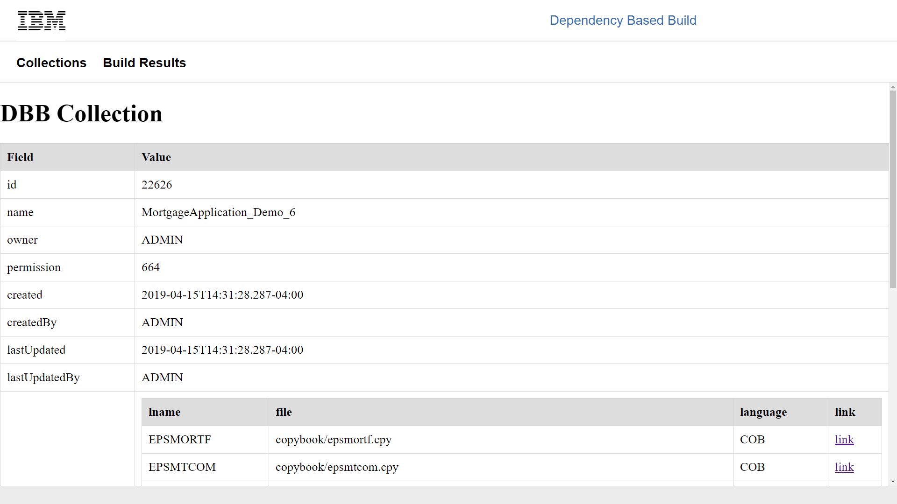
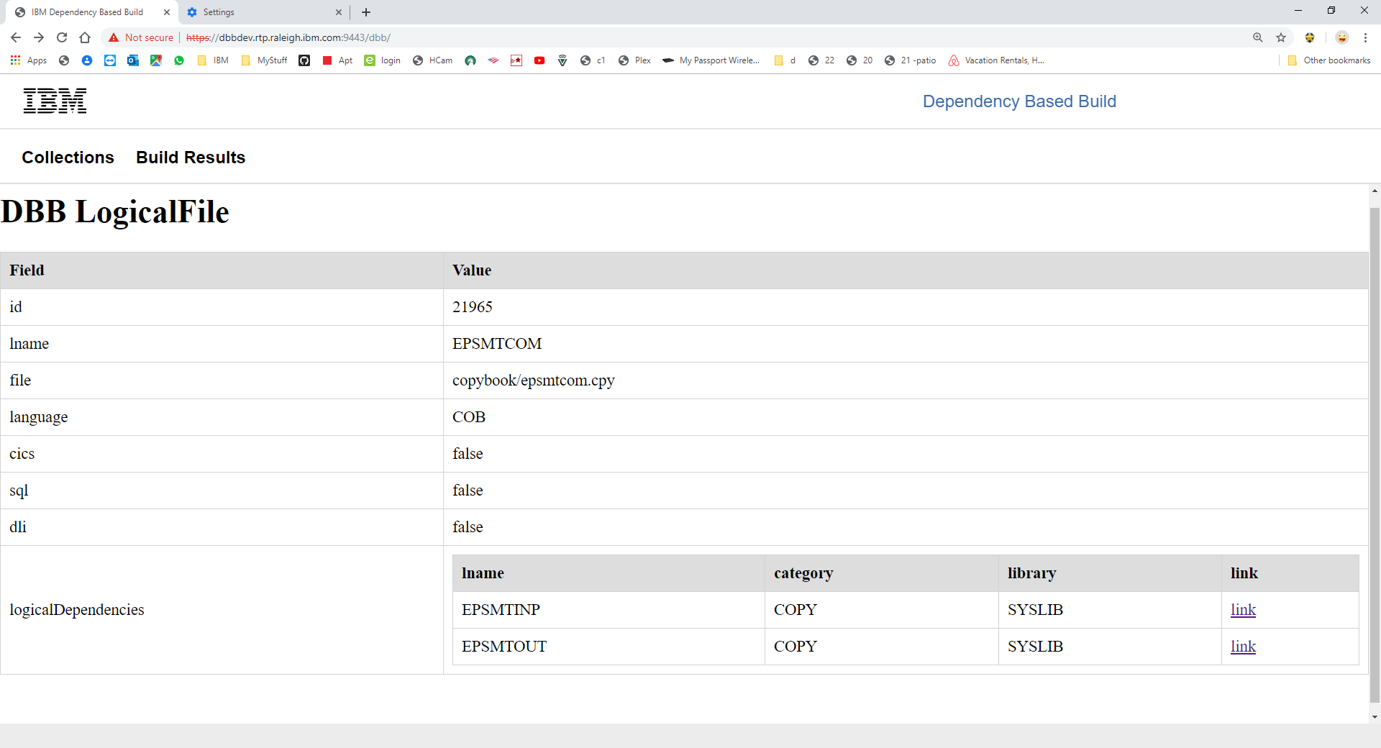
DBB’s WebApp - Application Metadata
DBB stores, maintains and queries your application’s program dependencies to other programs and source files like copybooks and BMS maps during a build.
Drill down for details

Slide 9
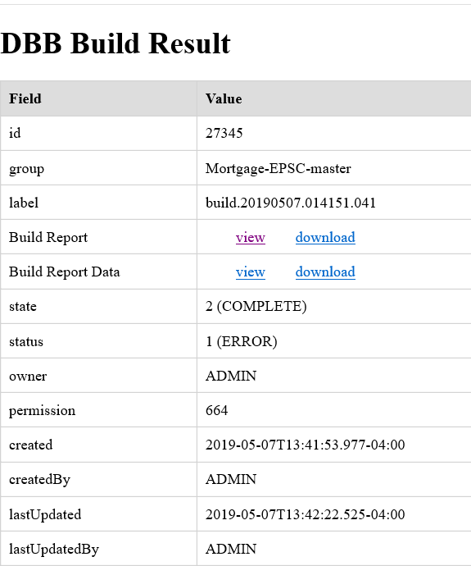
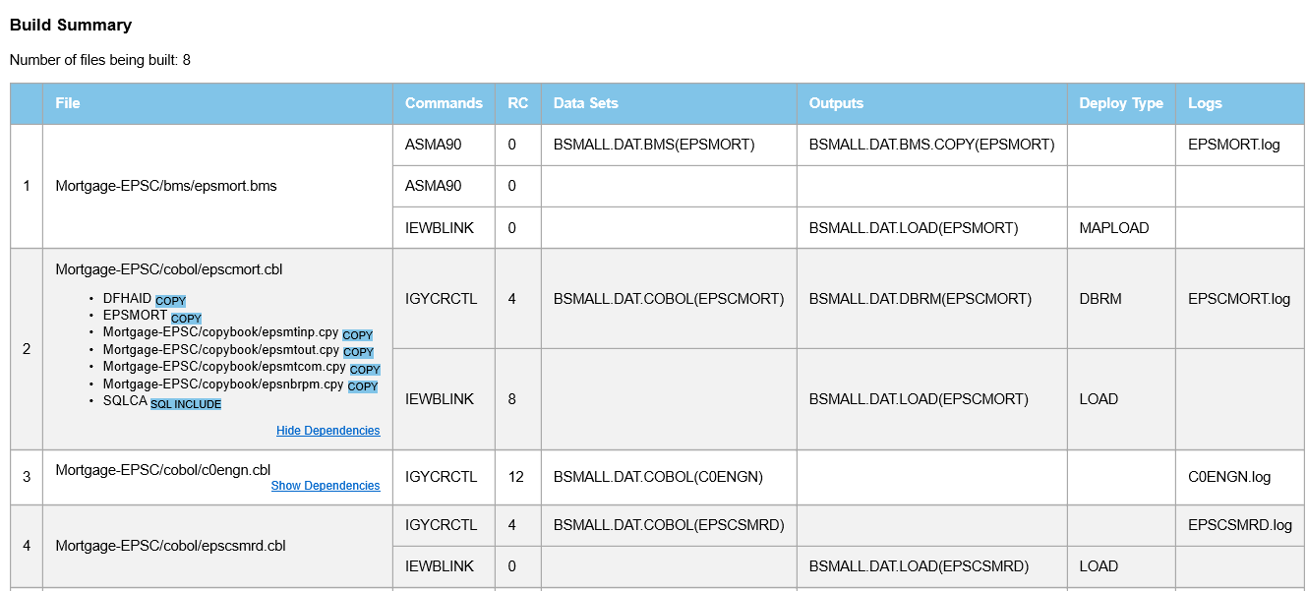
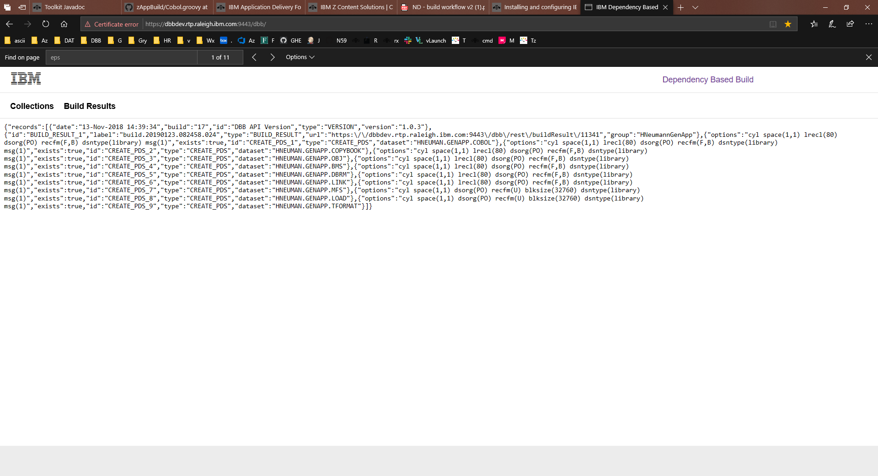
DBB’s WebApp – The Build Report
DBB generates build reports viewable from a browser. It also creates a machine-readable JSON file to drive your automated Continuous Deployment (CD) process.

Slide 10
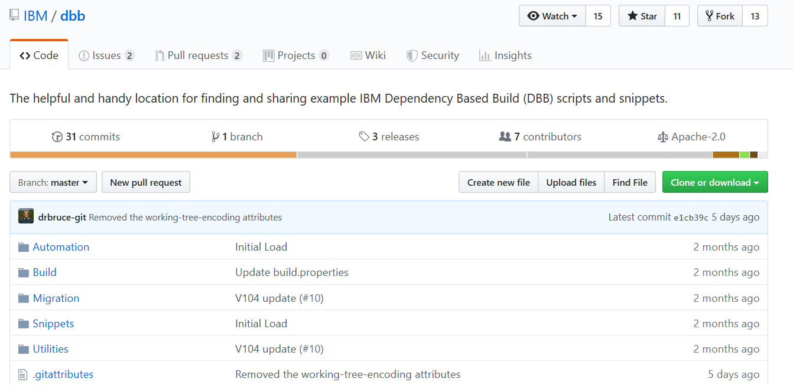
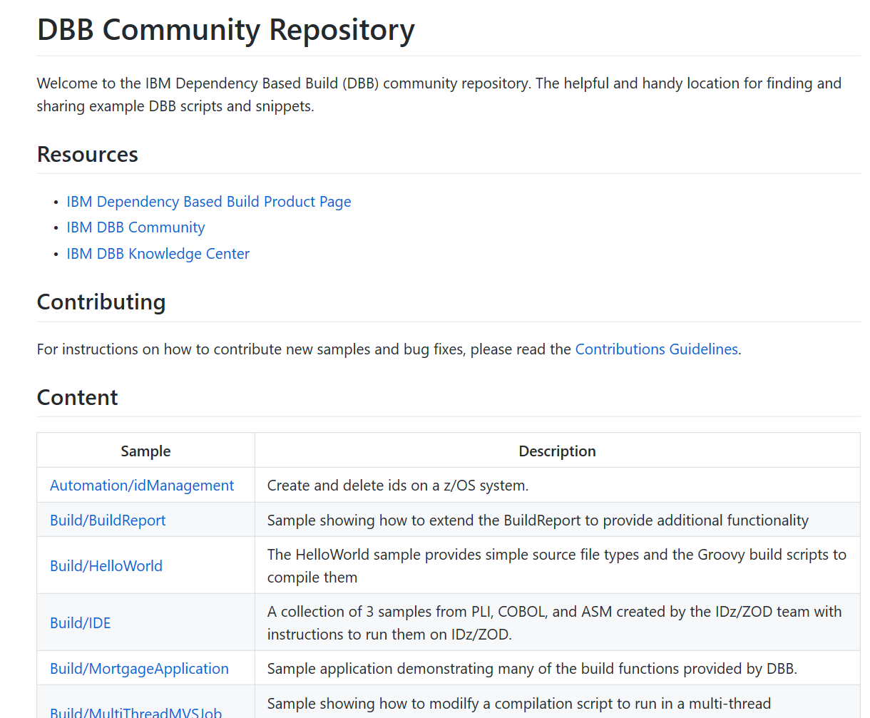
Find us on Git Hub - https://github.com/IBM/dbb
Samples, documentation and other resources
Case Study: https://developer.ibm.com/mainframe/2019/03/25/devops-transformation-on-ibm-z-with-git-and-ibm-dependency-based-build-a-case-study/

